Slide 1
ATG Tires Pvt. Ltd, Tirunelveli Plant
ATG LEADERSHIP COMPETENCY MODEL
Date :
1

Slide 2
Main Components of Competency
Behavioural
Personal attributes bundle which are considered essential for all employees regardless of their function or level.
Ex :Visioning, Adaptability, Flexibility, Managing Change, Communication, Initiative, Listening Skills, Team working, Continuous Learning
Functional
Specific competencies for technical aspect of the job
Ex: Market Product Research, C.I, Process Auditing, Factory Cost Reduction, EHS Policy Deployment, etc
Geri
2

Slide 3

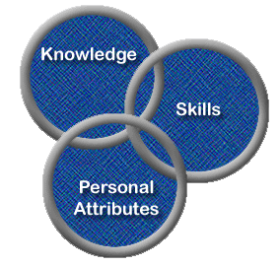
What is Competency Mapping?
Competency mapping is the process of identification of the competencies required to perform successfully in a given job or role or a set of tasks at a given point of time. It generally examines two areas: emotional intelligence or emotional quotient (EQ), and strengths of the individual in areas like team structure, leadership, and decision-making.
Competency mapping involves 2 steps
Step 1: Identification of vital competencies required to perform successfully in a given job or role
Step 2: Breaking a given role or job into knowledge, skills & Personal attribute components needed to perform the same successfully
A competency Mapping is an assessment tool used to observe, measure & evaluate the combination of IQ & EQ
3
Notes:
It generally examines two areas: emotional intelligence or emotional quotient (EQ), and strengths of the individual in areas like team structure, leadership and decision-making.

Slide 4
IDENTIFIED BEHAVIOURAL COMPETENCIES
ATC Leadership Model
People Safety F
Problem Solving
Focus on Self Development
Business Perspective
Accountability
Implementation
Team Working
Communication
Empowerment & Leadership
Customer Centric
Continuous Improvement

Slide 5
WHY- COMPETENCY MAPPING
Time management
Clear expectations
Coaching
Career planning
Capability development and workforce planning
Succession planning
Recruiting
Focus on performing roles
Evaluation, knowing where you are now
Building core competition

Slide 6
ISO 9001:2015
7.2 Competence
The organization shall:
a) determine the necessary competence of person(s) doing work under its control that affects the
performance and effectiveness of the quality management system;
b) ensure that these persons are competent on the basis of appropriate education, training, or experience;
c) where applicable, take actions to acquire the necessary competence, and evaluate the effectiveness of the actions taken;
d) retain appropriate documented information as evidence of competence.
NOTE Applicable actions can include, for example, the provision of training to, the mentoring of, or the reassignment
of currently employed persons; or the hiring or contracting of competent persons.

Slide 7
Functional Competency Parameters
The Functional Competencies are being worked out dept.wise.
For instance, a glimpse on Quality department competencies
QA Competencies Identified :
System Management
Quality Tools Application
Process Improvements
Dynamic Customer Management & Audit Compliance
People Performance Enhancement
7

Slide 8


Importance of Determining Competency
“வினைக்குரிமை நாடிய பின்றை அவனை அதற்குரிய னாகச் செயல்”.
குறள் விளக்கம் :
ஒருவன் ஒரு தொழிலைச் செய்வதற்கு உரியவனாக இருப்பதை ஆராய்ந்த பிறகு அவனைத் அத் தொழிலுக்கு உரியவனாகும்படிச் செய்ய வேண்டும்.
Allocate R&R to a particular person, after determining that he or she is exactly competent enough to perform the same.
----------------------------------------------------------------------------------------------
நூல் : திருக்குறள்
ஆசிரியர் : திருவள்ளுவர்
பால் : பொருட்பால் – அரசியல்
அதிகாரம் 52 : தெரிந்து வினையாடல்
குறள் : 518
8

Slide 9





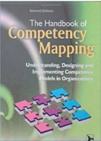
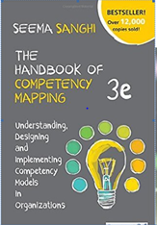
Sources of reference : Peer companies competency sets / global certified managerial competencies from websites of OECD/CIPD/HR Designs/ e-books
9

Slide 10
Competency Mapping –Work Planning R.A.D.A.R Logic
Identify and assess 'competency gaps' in individuals.
Focus employees on what is critical to enhance their performance.
Provide a roadmap for employee development and career planning.
To increase clarity in performance expectations and establish a clear link between individual and Unit goals.
Target : Min 5% Increase in KRA compliance %
Enhanced Focus & Strike rate on Policy deployment Matrix 17-18
RESULTS AIMED
10
Notes:
Providing valuable insights for creating highly targeted development and training initiatives.

Slide 11
Benefits of Competency Mapping
RESULTS
For the Organization
For the Employees
Reinforce corporate strategy, culture and vision across all levels
Raise the bar of employee’s KRA Performance
Increase the effectiveness of training and professional development programs.
Records the employee’s acquisition of skills, knowledge, safety and other procedures relating to each task
Reduce cost overruns caused by distortions or gaps in job expectations
Identify the SGOC Factors of success criteria (i.e., behavioural standards of performance excellence) required to be successful in their role
Sets clear performance expectations from the superior
Enables employees to be more proactive beyond their individual roles, by learning additional competencies that are valued by the organization
Notes:
2. expectations & educate employees to achieve the stated expectations
3. Establish expectations for performance excellence, resulting in a systematic approach to professional development, improved job satisfaction, and better employee retention.
4. by linking them to the success criteria (i.e., behavioral standards of excellence).
Provide more objective performance standards.
Provide a clear foundation for dialogue to occur between the manager and employee about performance, development, and career-related issues.
2. Support a more specific and objective assessment of their strengths and specify targeted areas for professional development.
4. for employees, enabling them to make better decisions and work more effectively

Slide 12

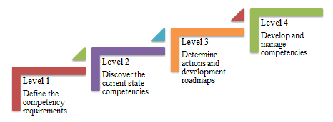
Methodology
APPROACH
12

Slide 13





Mapping Process
APPROACH
Preparation of Questionnaire
Collection
of Responses
Analysis
Findings

Slide 14
Rating & Inferences – Behavioural
RESULTS AIMED Rating Scale used – 1 To 5
Never- E Occasionally-D Sometimes-C Often-B Usually-A
Ratings are being gathered from 4 levels For the beginning, it is computed from
for each individual only 2 levels – Superior & Self
viz., ( Superior, Peer, Sub-ordinate & Self)
Assessment
MENTOR
PERFORMER
LEARNER
Above 85%
Between 55% - 84%
Below 35%
Between 36%- 54%
PRACTITIONER
14

Slide 15
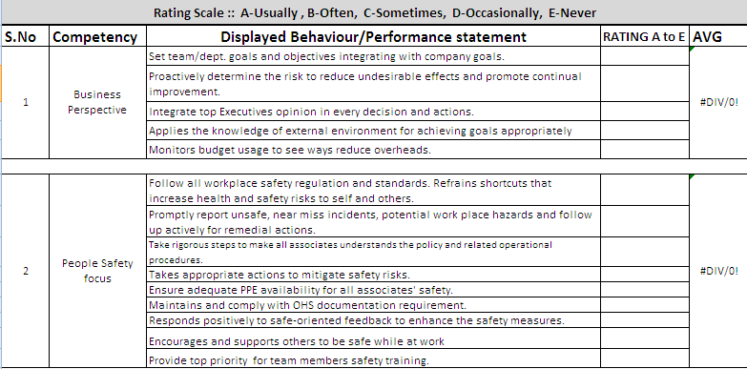
Assessment Sheet Model
APPROACH
15

Slide 16
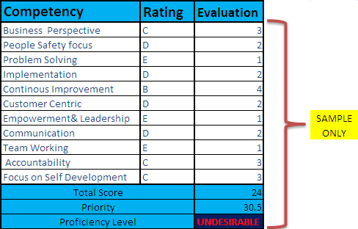
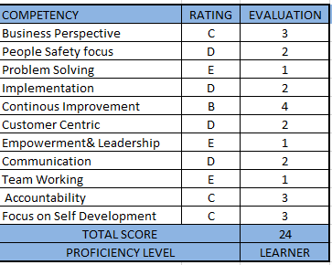
ASSESSMENT
16
Notes:
Priority = Importance x Performance Gap
Performance Gap = Current Level of Performance ÷ Desired Level of Performance
Performance Gap=24 ÷ 55=0.436
Priority = 0.436 * 70%=30.52% (out of 70%)

Slide 17
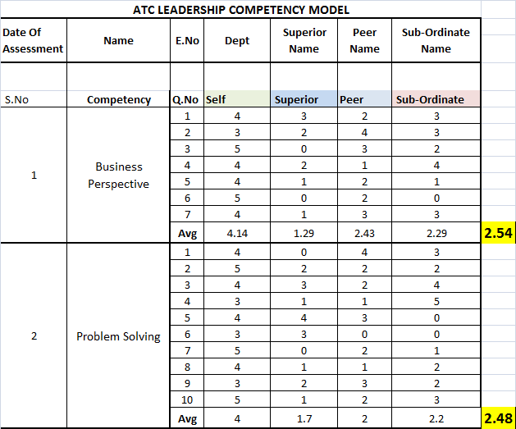
Score Sheet Template
ASSESSMENT
17

Slide 18
X-Proficiency Radar Chart

Slide 19
WHY -180 ?
DEPLOYMENT
DEPLOYMENT
Introduction of new framework
Time constraints
Since identified personnel are at the same level
Reality check
Clarifies expectations
Out in the open
Simpler report
Fetching Quick Results
Notes:
Reality check – allows the person being rated the benefit of comparing self-perception of strengths and weaknesses against those of his or her manager
Clarifies expectations – often we think we know what is most important on the job, but we could be out of sync with our manager – a 180 allows the supervisor to weigh in on priorities and subsequent discussion can make expectations crystal clear!
Out in the open – a typical 360 features anonymity (the person being rated doesn’t know who said what) and can be shrouded in mystery and even suspicion; with a 180 the person being rated knows who said what – no mystery and all data!
Simpler report – data resulting from a 180 exercise in the participant’s output report shows self, supervisor and norm group – 3 powerful data points; this is plenty to consider for development planning and are also probably the most important data points to consider anyway!
Less annoying for raters – if you consider that a typical 360 involves about 12 raters (self, supervisor and 10 peers / direct reports), you are probably running multiple participants through the assessment which means that you may be asking raters to complete surveys for multiple participants which can become annoying and tiresome (rater fatigue), rendering the resulting data less reliable and consuming time away from core job duties. A 180 solves this problem.
Quick and more affordable – one of the drawbacks of a 360 is that it becomes a lengthy and tedious process, getting everyone to do their rating on time and completely (lots of follow-up time, calls and emails from HR!). With just the two raters, a 180 can be done quickly (a day or two, typically) with no follow-up time or effort needed. Whereas 360’s run closer to $100 per person, the same version as a 180 is generally a faction of the cost.

Slide 20

20

